Slide 1
Team: DEVILS DEN
PIPELINE IQ
Agentic CI/CD Repair & Intelligent Release Orchestration
Domain: DevOps
Problem Statement: T1PS1
Team Members:
Tanya Rishikesh
Naman Mani
Indraneel Chatterjee
Team Leader : naman.mani23@st.niituniversity.in
College Name: NIIT University

Slide 2
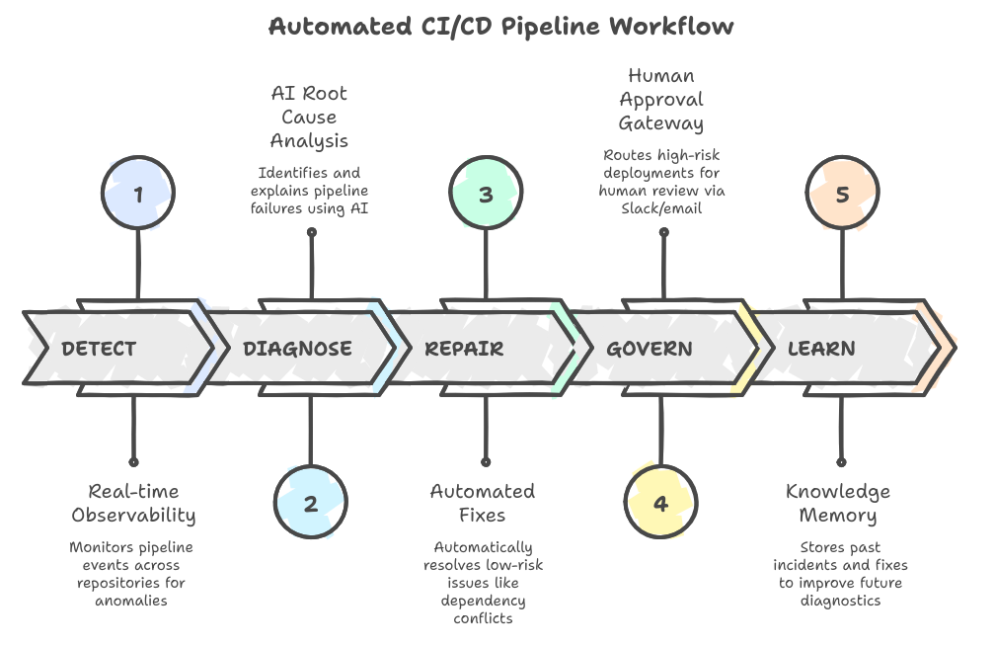
Solution Overview: Pipeline IQ
A multi-agent orchestration system that monitors CI/CD pipelines in real-time, diagnoses failures using contextual signals from commits, logs, and tests then repairs common issues while enforcing human-on-the-loop governance for high-risk deployments actions. Built on event-driven architecture powered by Apache Kafka, independent AI agent process pipeline events asynchronously, enabling scalable monitoring, automated remedies and complete auditing of the fixes

Slide 3
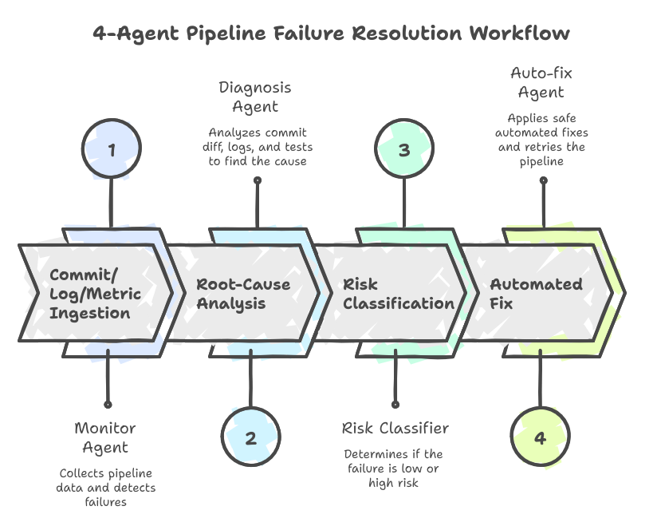
The 4-Agents Workflow
Monitor Agent: Reads pipeline data and detect anomalies(if any)
Diagnosis Agent: Analyzes reports and context to find the "Why“
Risk Classifier: Determines if issue is minor or high-risk based on environment and impact
Auto-Fix Agent: Applies the repair and retries the pipeline
Notes:
Change content

Slide 4
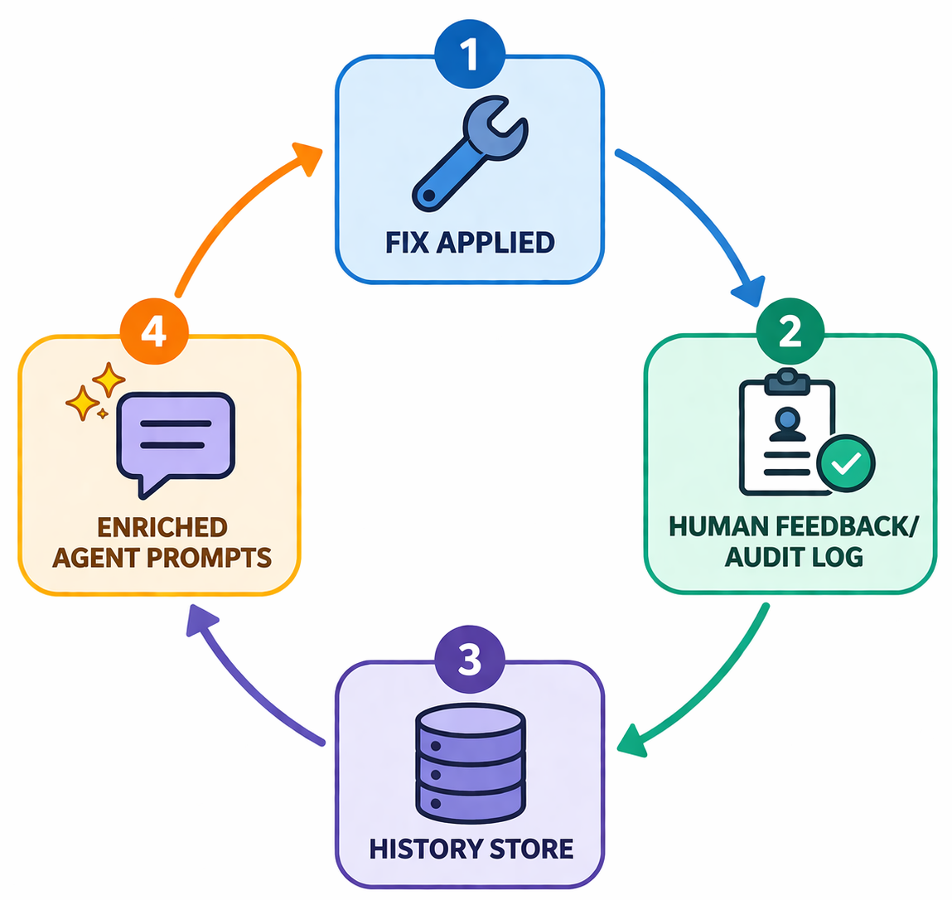
The Self-Learning Engine
Feedback Loops: Every successful fix and every human intervention is stored in a Knowledge Memory (MongoDB).
Prompt Enrichment: The system uses past incident history to "prime" the Diagnosis and Risk agents for future errors.
The Result: The system doesn't just fix errors; it evolves to predict and prevent them based on your specific codebase

Slide 5
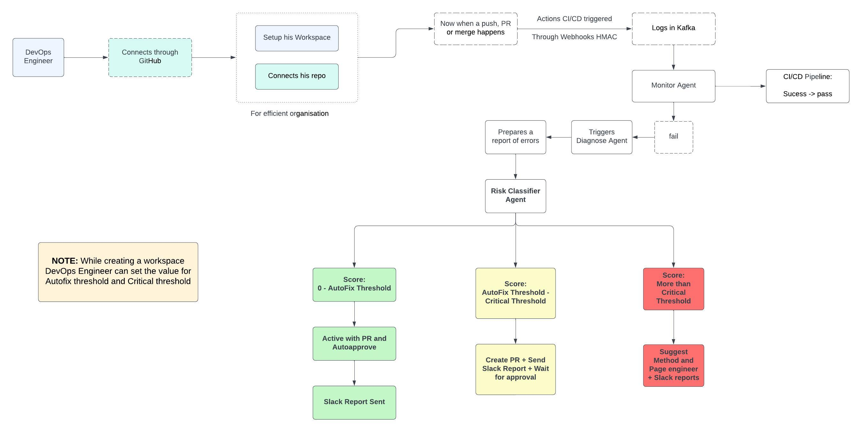
Workflow
Notes:
Naman fixing

Slide 6
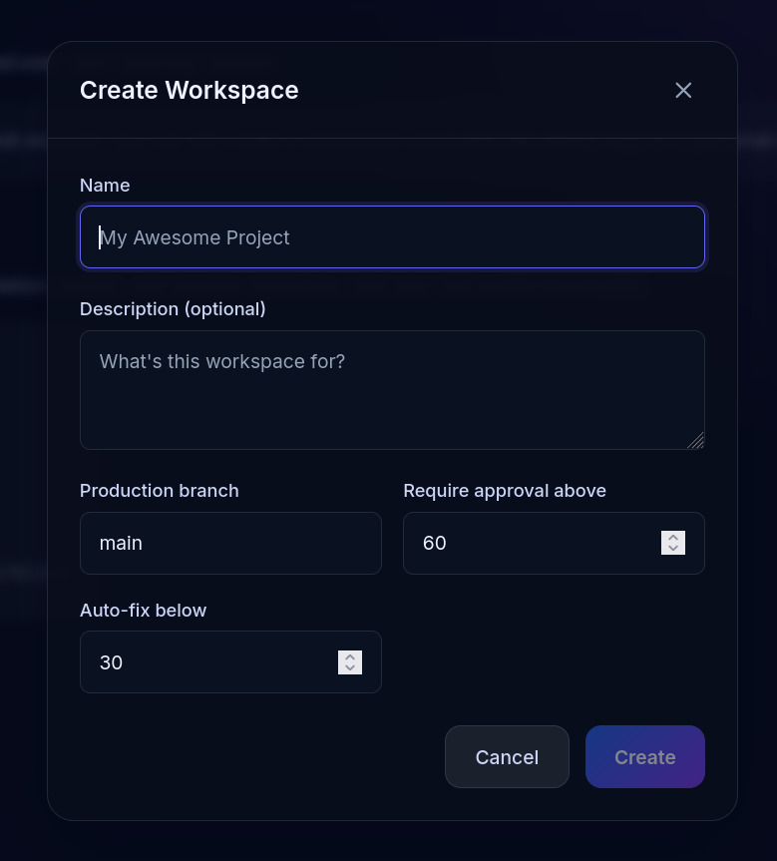
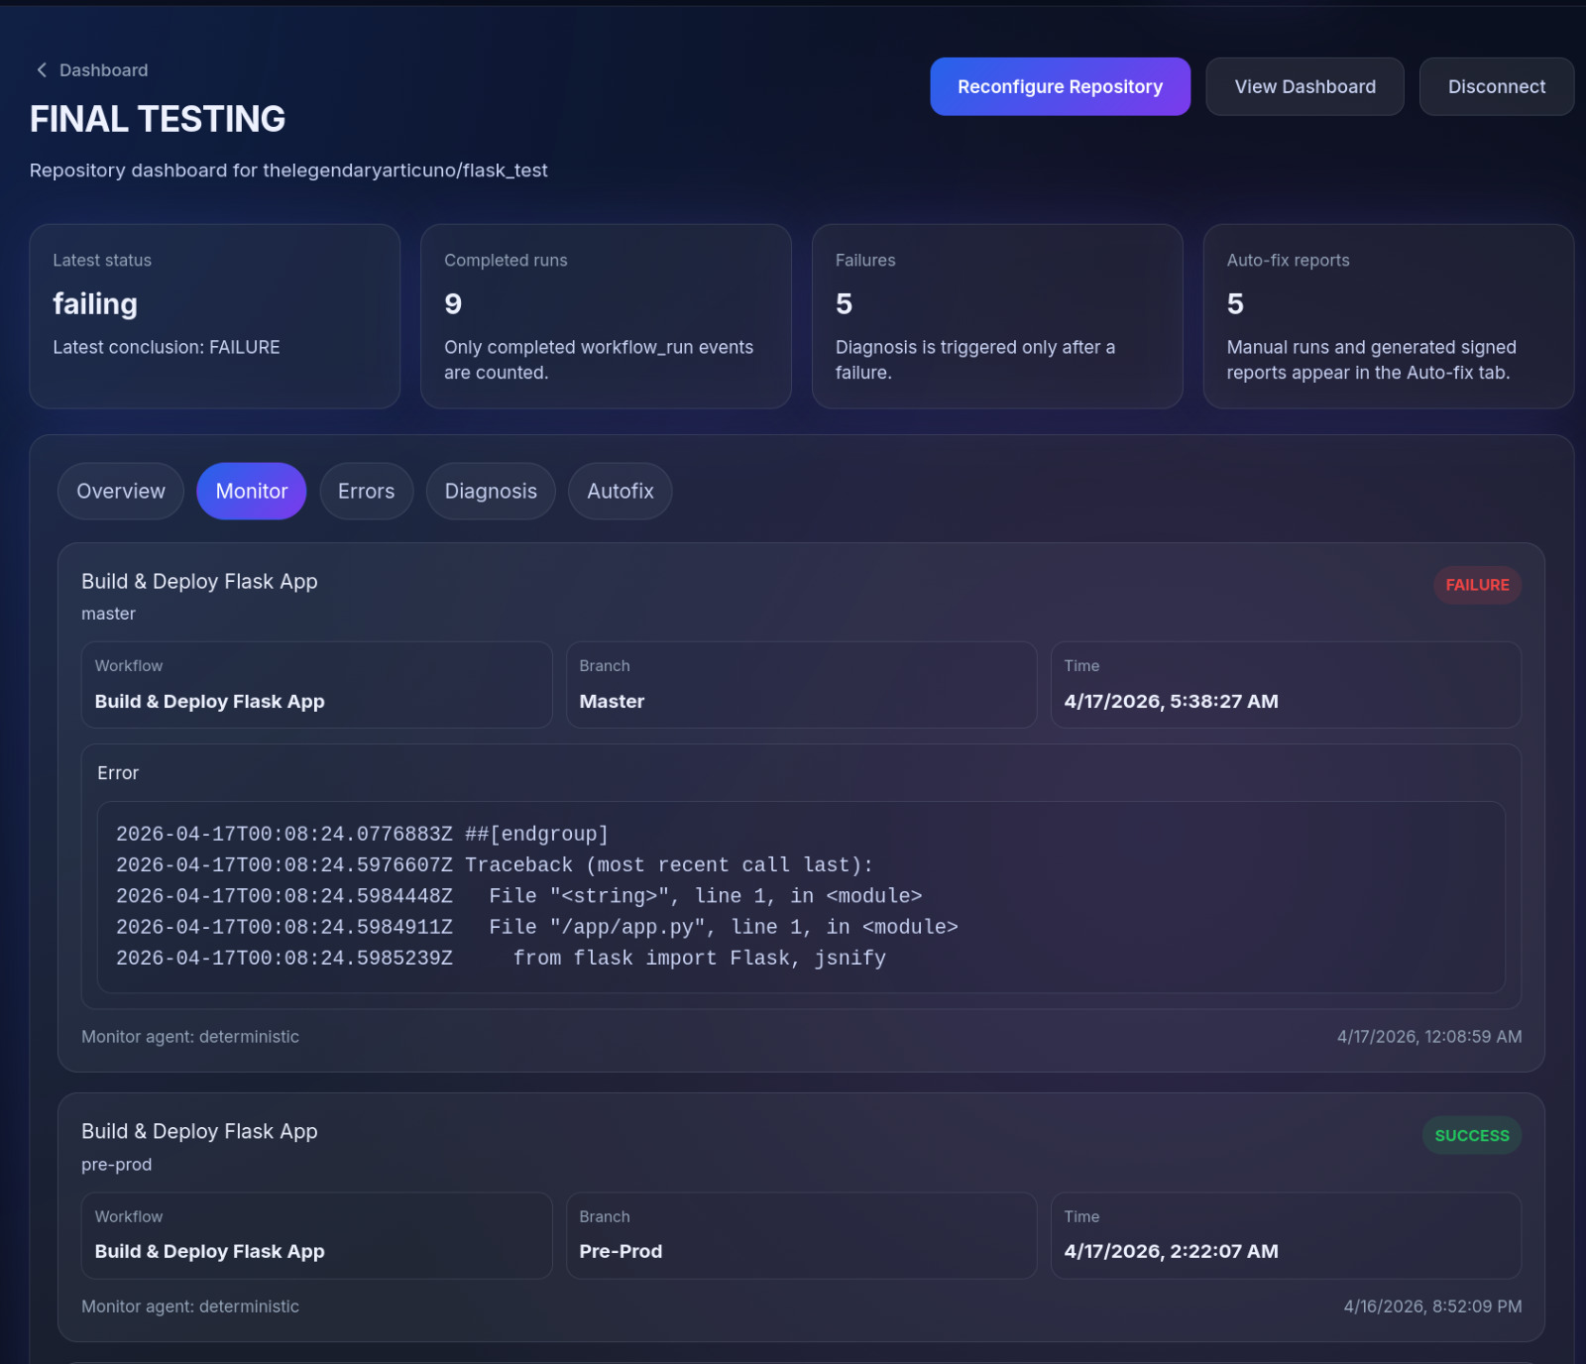
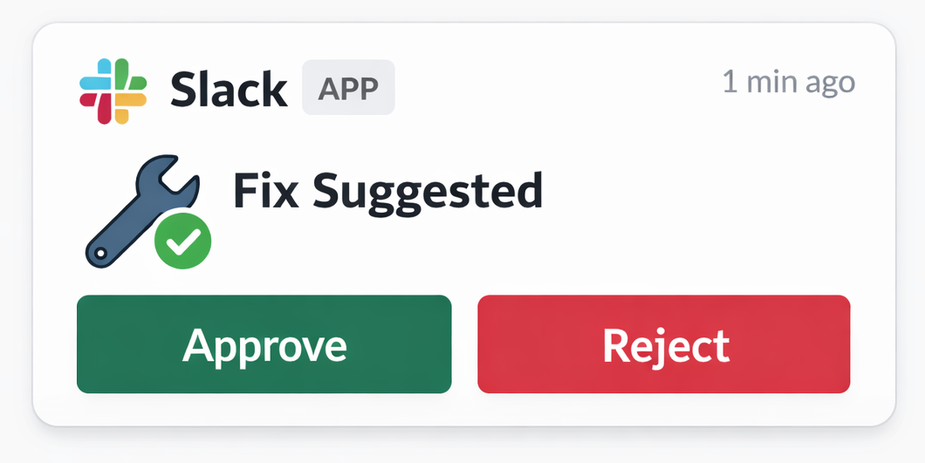
Safety & Governance
Risk-Based Decision Making Actions are classified based on environment, change impact, and failure severity
Human-in-the-Loop Approval High-risk fixes require explicit approval before execution
Controlled Auto-Fix Mechanism Limits repeated attempts to prevent infinite or unsafe actions
Audit & Transparency All actions, decisions, and fixes are logged for traceability
Human Approval
Setting up Risk Threshold
Logs for Transparency & Audit
Notes:
Can be better

Slide 7
Comparative Analysis
 | CodeRabbit | GitHub Copilot | PagerDuty | Pipeline IQ
Stage | Pre-merge | Code writing | Post-failure | CI/CD runtime
Understands pipeline context | ❌ | ❌ | ❌ | ✅
Uses logs + tests + commits | ❌ | ❌ | ✅ | ✅
Suggests fixes | ✅ | ✅ | ✅ | ✅
Auto-fixes small issues | ❌ | ❌ | ❌ | ✅
Human-in-loop governance | ❌ | ❌ | ✅ | ✅
Resolves pipeline failures | ❌ | ❌ | ❌ | ✅
Existing tools focus on code creation, review, or alerting. Pipeline IQ focuses on actively resolving CI/CD failures in real time using contextual intelligence.
Notes:
Need structure

Slide 8
Conclusion
Pipeline IQ redefines CI/CD by transforming pipelines from reactive systems into intelligent, self-healing ecosystems. By combining multi-agent AI, event-driven architecture, and human-in-the-loop governance, we reduce debugging effort, minimize downtime, and enable safer, faster releases.
Key Takeaways & Future Scope
Automated failure diagnosis & real-time auto-repair
Context-aware decisions using logs, commits & test signals
Risk-aware deployment with human approval layer
Scalable architecture using event-driven systems (Kafka)
Integration with tools like Jenkins, Kubernetes
Scalable for enterprise DevOps

